Slide 1


Slide 2




EagleSat-1 Continuing Embry-Riddle’s CubeSat Satellite Development Program
Presented by
Clayton G. Jacobs
Embry-Riddle Aeronautical University, Prescott
EagleSat Student Project Manager
Mentor: Dr. Gary Yale

Slide 3
Outline
Background
Subsystems Overview
Timeline
Testing
Launch/Operation
Documentation
Challenges

Slide 4
Background
ERAU CubeSat Launch Initiative (CSLI) proposal accepted by NASA during Spring 2012 selection period for a 1U CubeSat.
Primarily student run extracurricular project.
Subsystem teams exist to delegate tasks and share in the development.
Teams actively recruit students who are interested in getting involved.
Notes:
Student run - Student run project along with multiple faculty mentors with experience in related fields

Slide 5
Background
Program Objective:
Provide an educational experience for students involved and STEM outreach.
Technical Objective:
Monitoring the de-orbit (re-entry) cycle of the satellite through the use of a GPS receiver

Slide 6
Subsystems
Structures
On-Board Computer
Electrical Power
Super capacitor Energy Storage
Solar Panels
Communications
436MHz AX.25 Packet System
GPS Payload
Unlocked, Space-Rated GPS Receiver with LNA

Slide 7
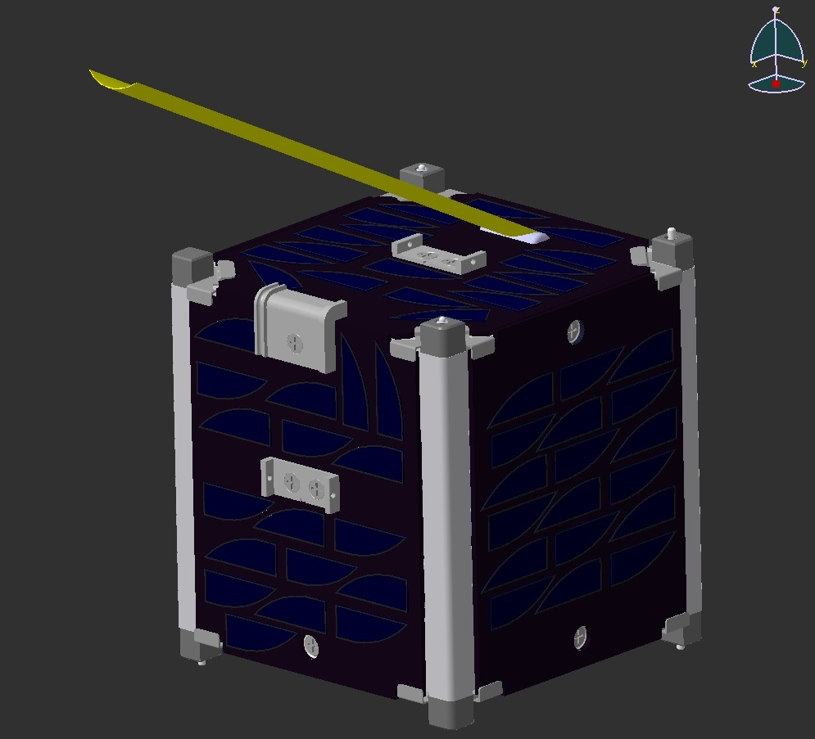

Slide 8
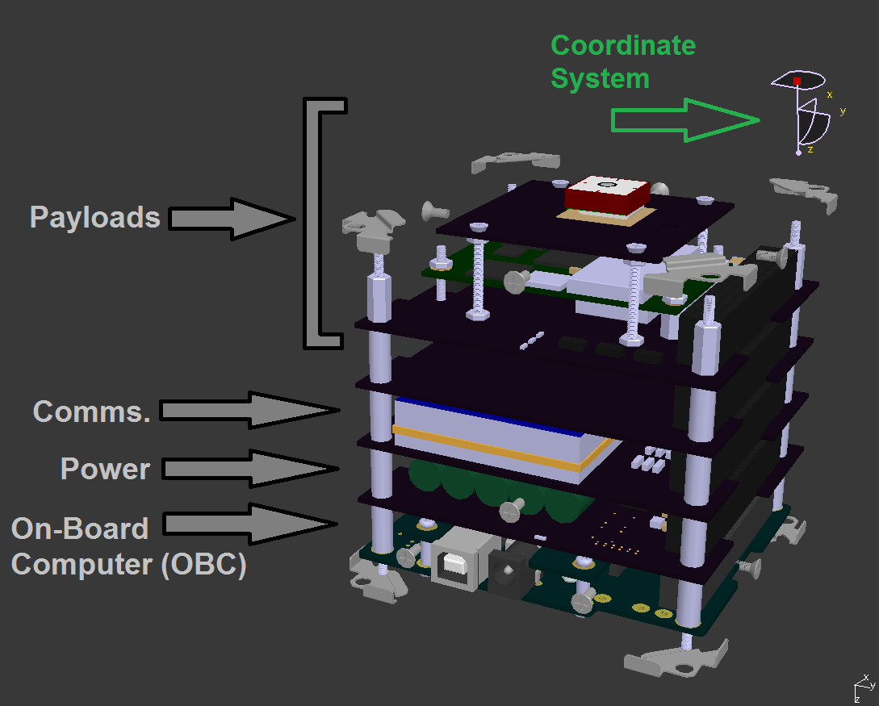

Slide 9
Timeline
02/01/13 Acceptance from NASA
11/11/13 Preliminary Design Review
04/06/15 Technical Review I
11/16/15 Technical Review II
06/01/16 Fabrication Complete
TBD Testing
09/01/16 NASA Mission Readiness Review
10/01/16 Satellite Delivery

Slide 10
Testing
Required Proto-flight Tests
Venting Analysis
Shock Test
Vibration Test
Mass Properties Analysis
Day in the Life Testing
Testing will be performed both in-house and through approved providers.

Slide 11
Launch/Operation
EagleSat-I is scheduled to launch on January 20th, 2017 with the JPSS-1 satellite from Vandenberg AFB.
The team is practicing satellite operation techniques and has a plan to receive data via our amateur radio ground station and data analysis software
Operation lifetime is 1 year with an orbital lifetime of 10+ years.

Slide 12
Challenges
Managing individual and engineering schedules
Balancing engineering/academic workloads
Summer workforce planning
Long term student retention to prepare for satellite operation
Past experiences with software complexities
Surface mount soldering design and fabrication

Slide 13
Acknowledgements
Dr. Gary Yale, Dr. John Post, and Jack Crabtree
ERAU College of Engineering
Arizona NASA Space Grant Consortium
The 2015-2016 EagleSat Student Team

Slide 14
Thank you for your attention.
Contact:
Clayton G. Jacobs
jacobsc6@my.erau.edu

